Slide 1
Course 1 Final Project
Static Website
Kim Tae Jung
My Portfolio website

Slide 2
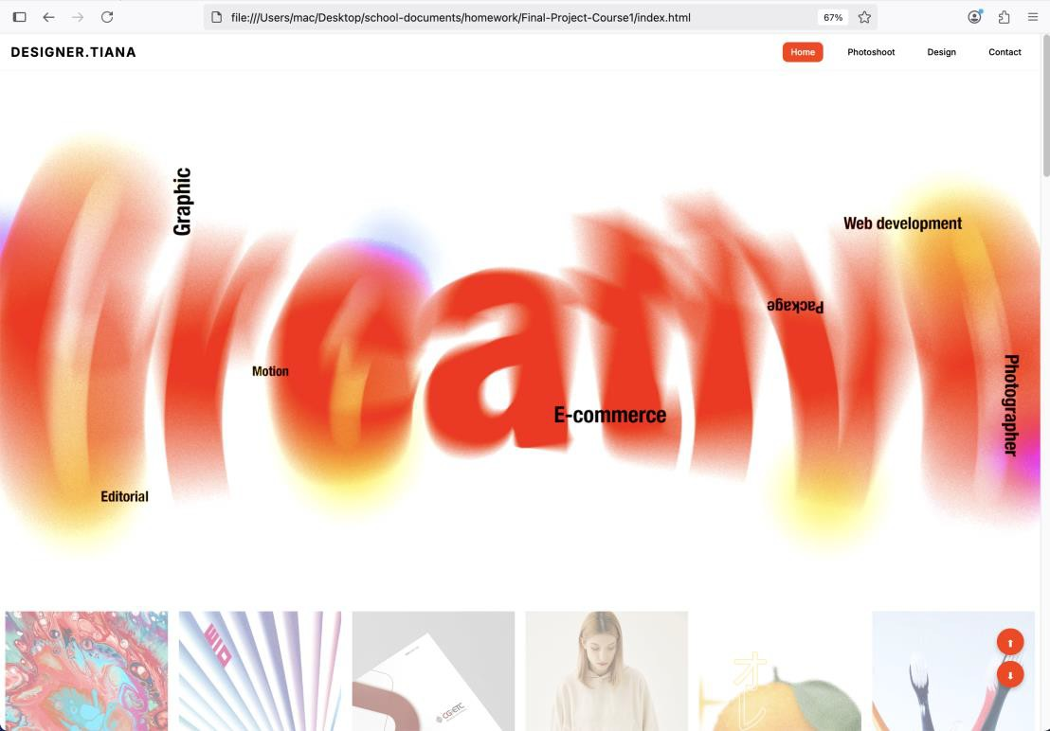
Tae jung - My Portfolio web
Static Website - Final Project
My Project
1 of 30: Showcase your Website
Open your website on a browser, and answer these questions:
What is your website about?
What pages and content does it have?
How do you navigate through your website?

Slide 3
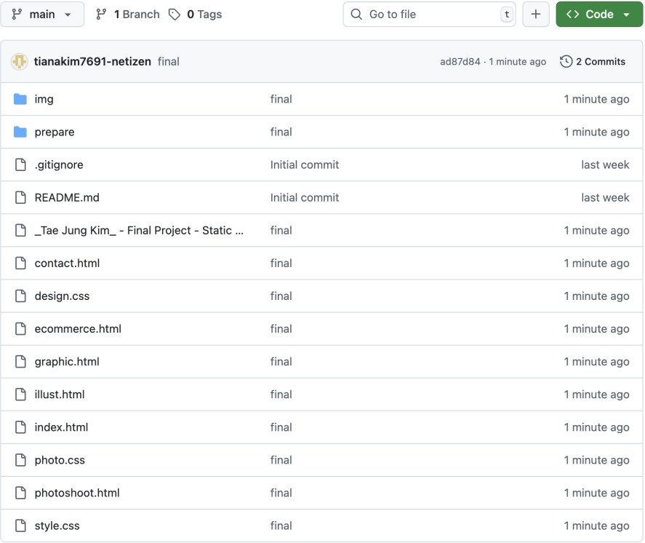
GitHub Repository
Static Website - Final Project
Tae jung - My Portfolio web
2 of 30: Share your GitHub repository
Answer these questions:
<your GitHub repository link>
a) Is your project on GitHub? b)
How can a potential employer check it out? (clone)

Slide 4
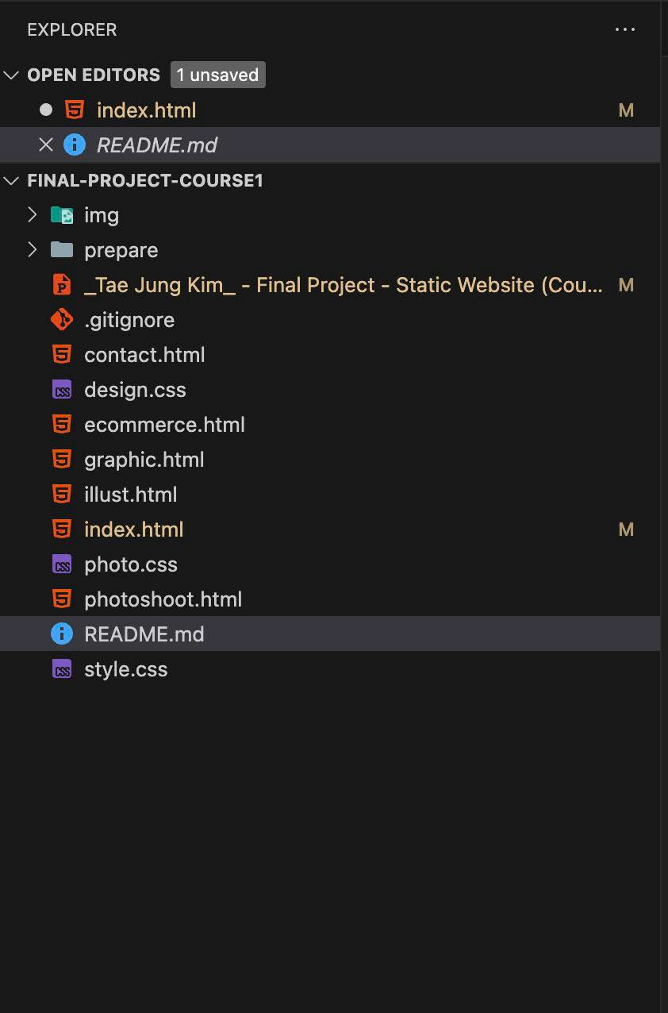
Tae jung - My Portfolio web
Static Website - Final Project
Project File Structure
3 of 30: Showcase how your Files are Organized
Answer these questions:
Do you have an index.html at the root?
If it isn’t at the root explain why.
Do you have other HTML pages? Where?
Do you have CSS files? Where?
Where/how do you organize your assets?
What other files do you have, if any?

Slide 5
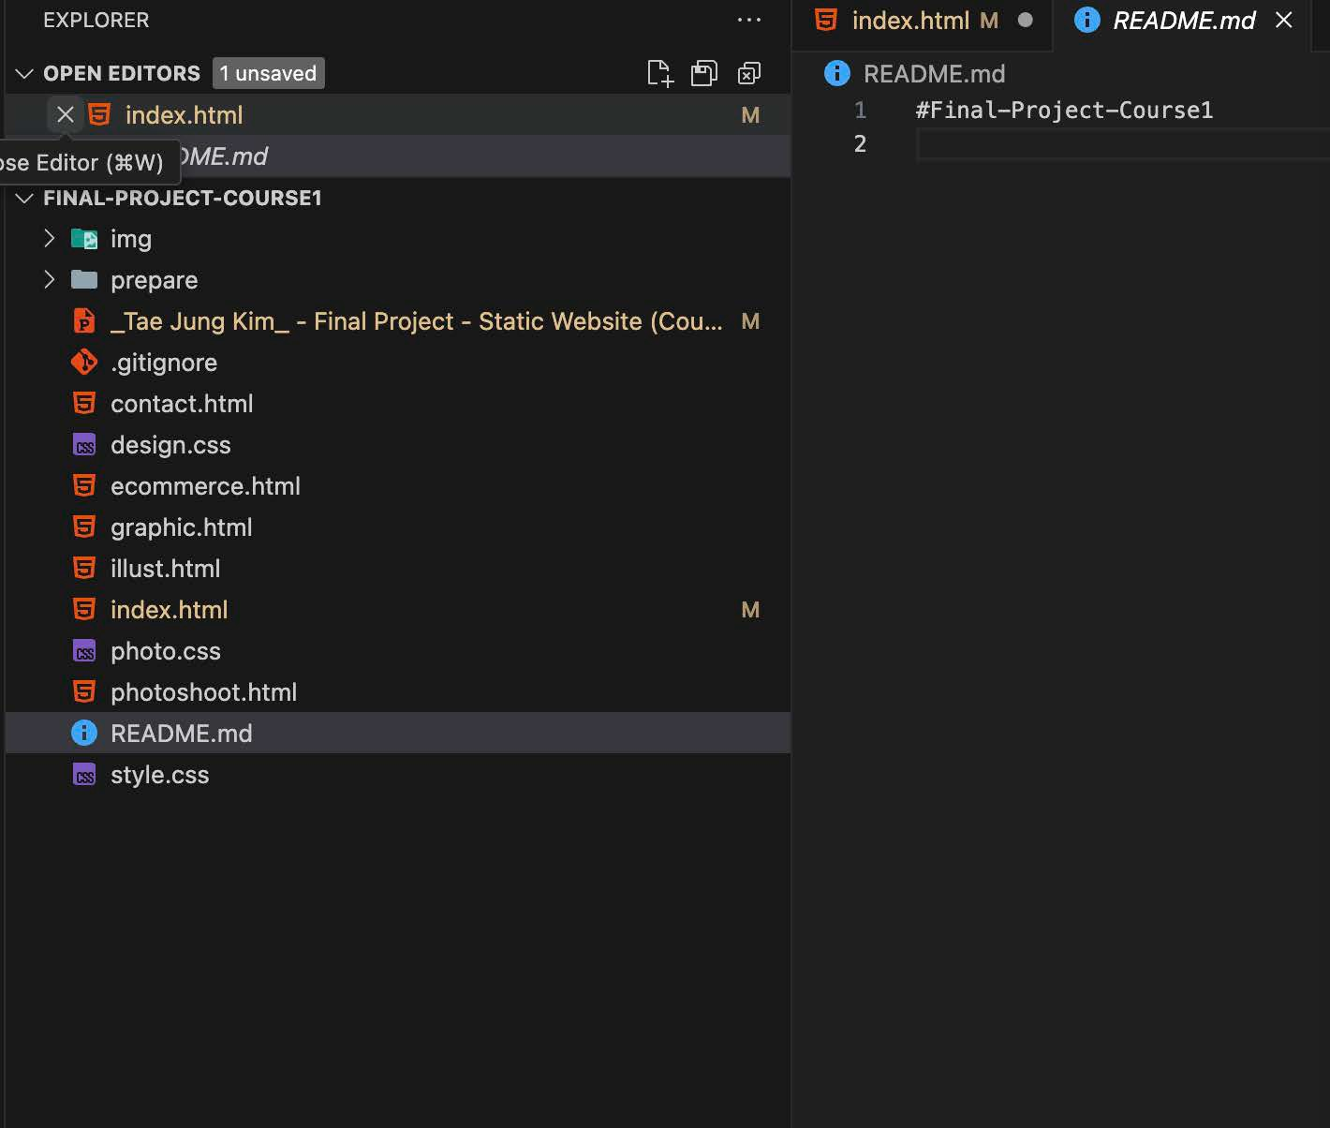
YTae jung - My Portfolio web
Static Website - Final Project
README File
4 of 30: Showcase how you document with README file
Answer these questions:
Do you have a README.md file?
Where is it in the project structure?
What does it have?
Does it describe the project well?
Does it indicate who the author(s) and contributor(s) of the project are?
If necessary, does it include instructions for how to use or navigate your web project?
iv) Is the README file formatted well?
iii)

Slide 6
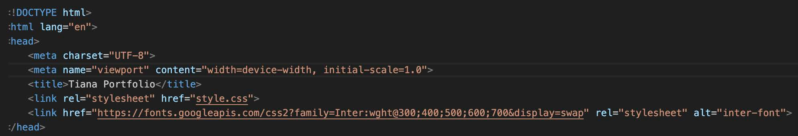
Tae jung - My Portfolio web
Static Website - Final Project
HTML5 Boilerplate
5 of 30: Showcase how you use HTML5 boilerplate
Answer these questions:
Does your html have:
DOCTYPE
lang attribute in <html>
charset metadata
viewport metadata
page title

Slide 7
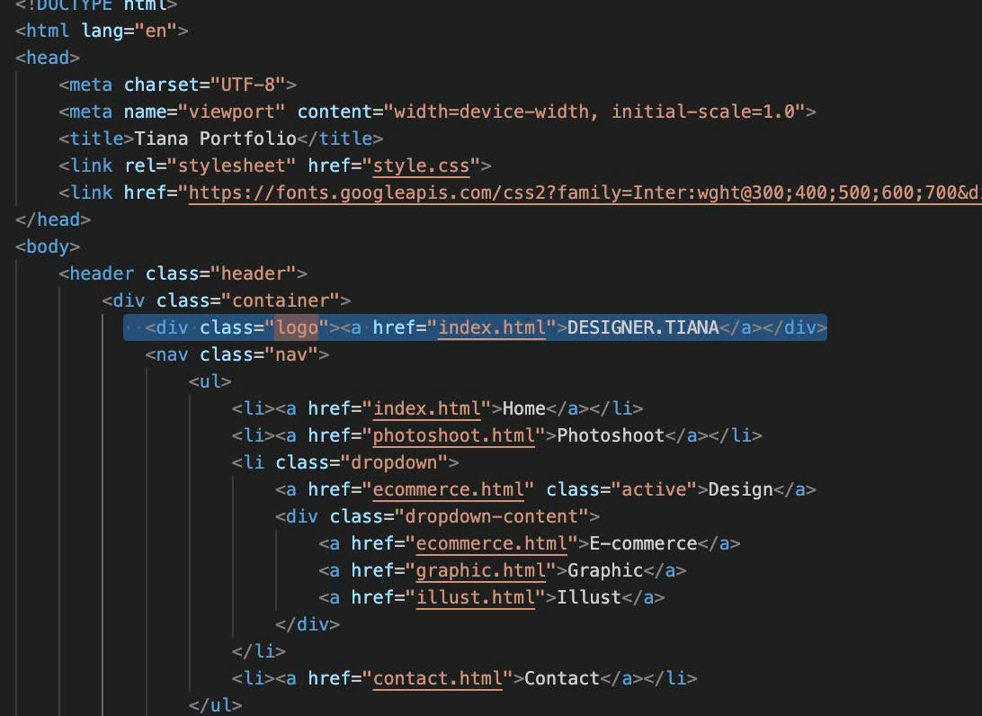
Tae jung - My Portfolio web
Static Website - Final Project
Landing Page Navigation
6 of 30: Showcase landing page navigation
Answer these questions:
Which page is the one that browsers will load initially?
How do you handle navigation to other parts of the landing page, and/or to other pages in the website?

Slide 8
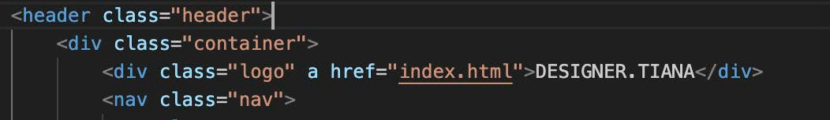
Tae jung - My Portfolio web
Static Website - Final Project
Multi-Page Navigation
7 of 30: Showcase navigation between pages
Answer these questions:
How do you handle navigation from other pages back to the home page?
How do you handle navigation between pages (back-and-forth) in general?

Slide 9
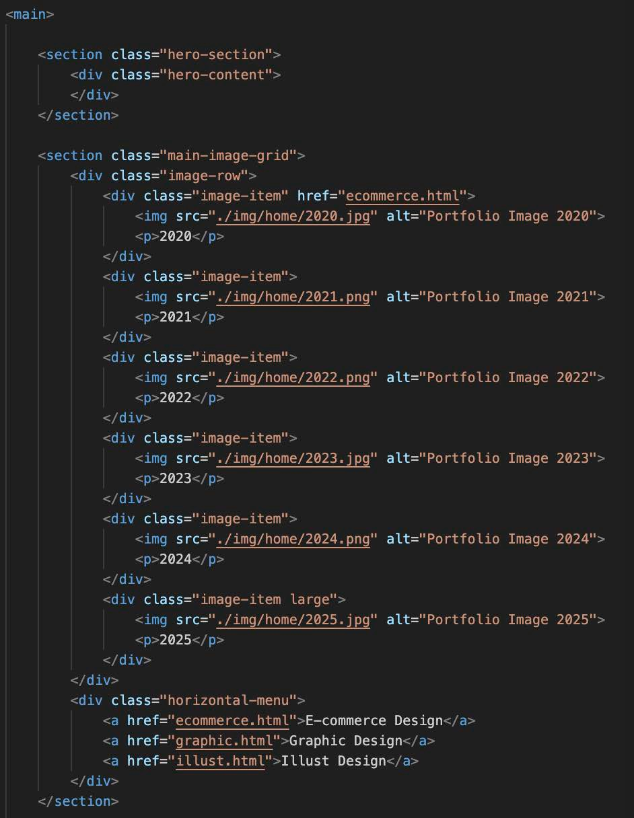
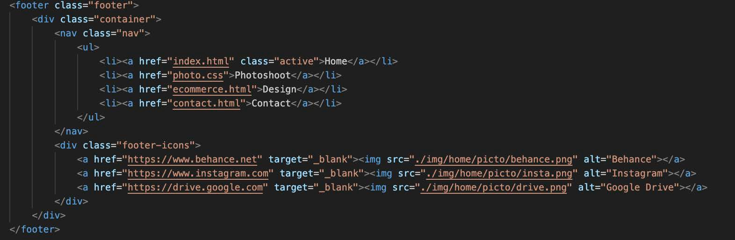
Tae jung - My Portfolio web
Static Website - Final Project
General HTML Structure & Format
8 of 30: Showcase HTML structure
Answer these questions:
How are your HTML elements nested?
Do you have a <header> section?
If so, what is in it? If your <nav> is not in it explain why.
Do you have a <main> section?
If so, what is in it? If not, explain why.
Do you have other <sections>? Which?
Do you have a <footer>?
Do you have other section elements?
Ensure there are no noticeable issues with how your HTML is structured and formatted.

Slide 10
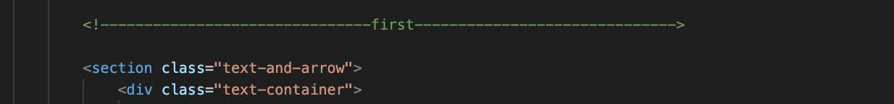
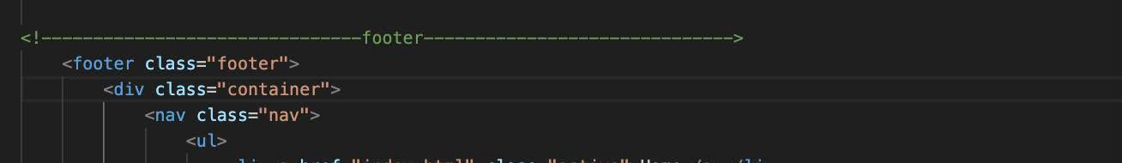
Tae jung - My Portfolio web
Static Website - Final Project
HTML Comments
9 of 30: Showcase use of HTML comments
Answer these questions:
Did you use comment lines in your HTML?
Give some examples of where, how and why.

Slide 11
Inline CSS
Static Website - Final Project
Tae jung - My Portfolio web
10 of 30: Showcase inline CSS
Answer these questions:
Can you show one example of inline styling?
Add one or more screenshot(s) of inline CSS in your project,
and remove this frame and text.

Slide 12
Internal CSS
Static Website - Final Project
Tae jung - My Portfolio web
11 of 30: Showcase internal CSS
Answer these questions:
a) Can you show one example of internal styling?
Add one or more screenshot(s) of
internal CSS in your project, *make sure to show the <style> elements and where they are placed in the project,
and remove this frame and text.

Slide 13
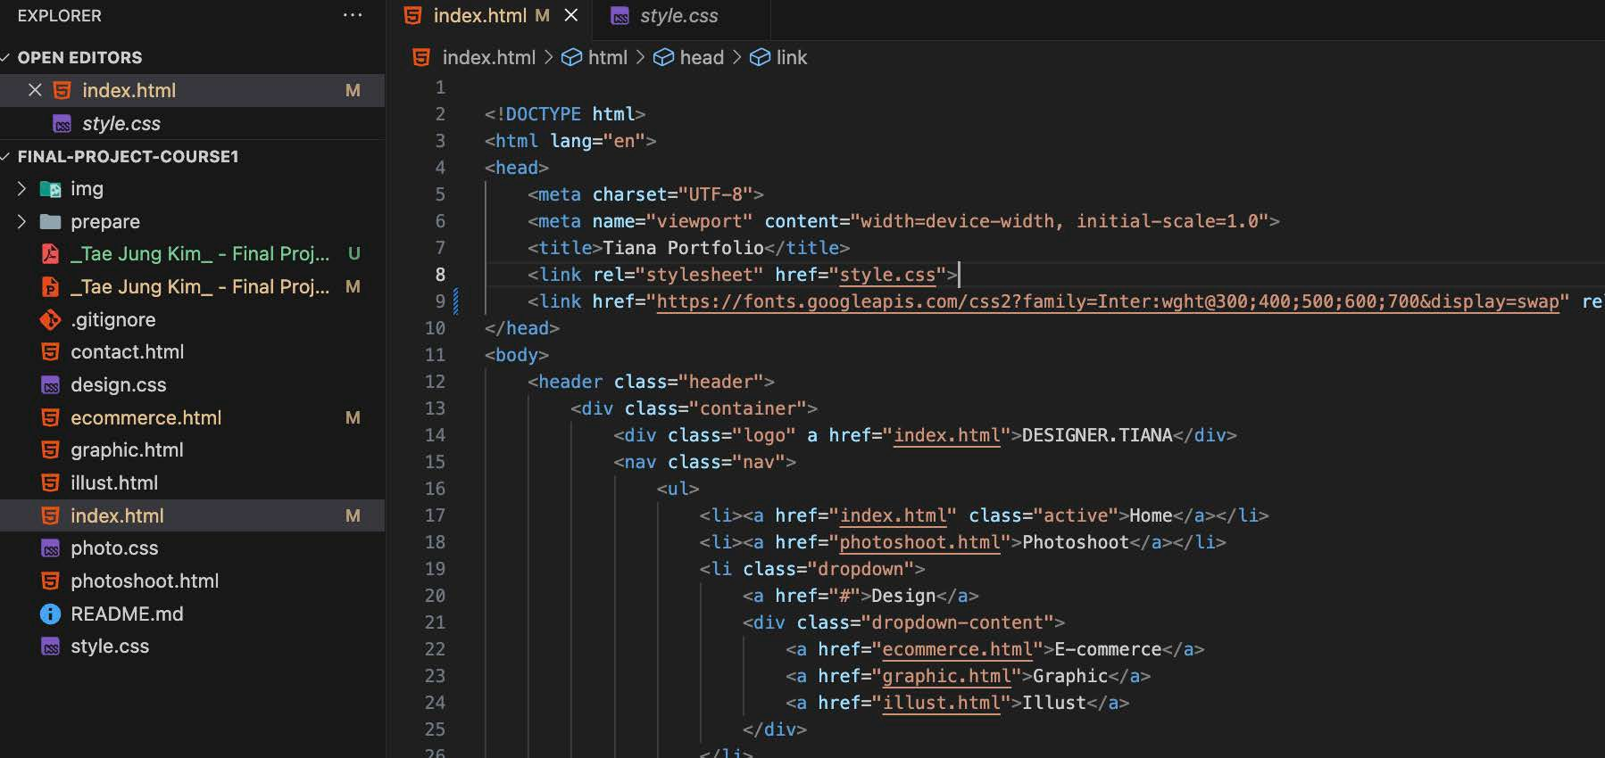
Tae jung - My Portfolio web
Static Website - Final Project
External CSS
12 of 30: Showcase external CSS
Answer these questions:
a) Did you use external styling in your project?

Slide 14
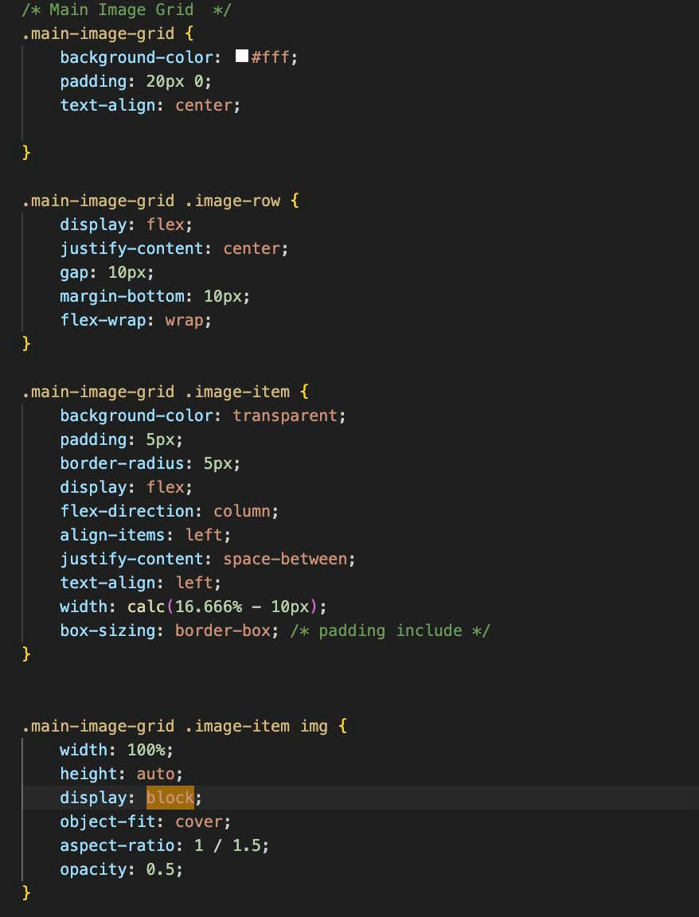
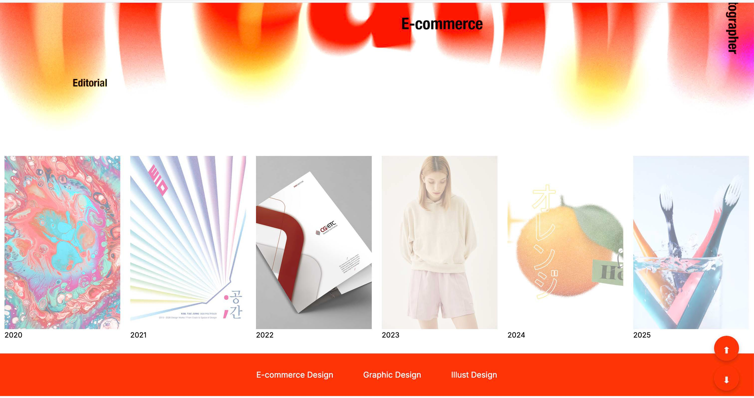
Static Website - Final Project
Tae jung - My Portfolio web
13 of 30: Showcase block elements
Answer these questions:
a) What is an example of an element with block display CSS Block Display
in your project?

Slide 15
Tae jung - My Portfolio web
Static Website - Final Project
CSS Inline Display
14 of 30: Showcase inline elements
Answer these questions:
a) What is an example of an element with inline display in your project?
Note: Many elements have display inline by default, so you do not need to explicitly give it in your CSS. Simply indicate an element in your project that has inline display and why.

Slide 16
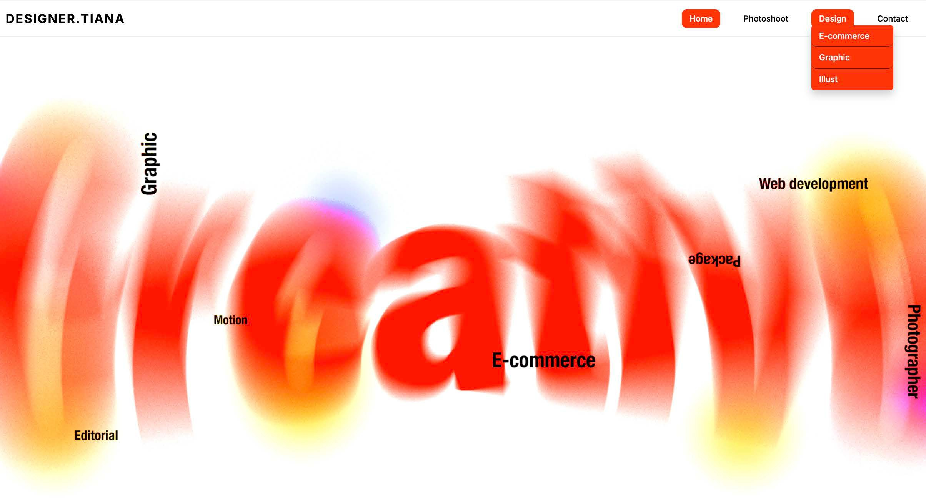
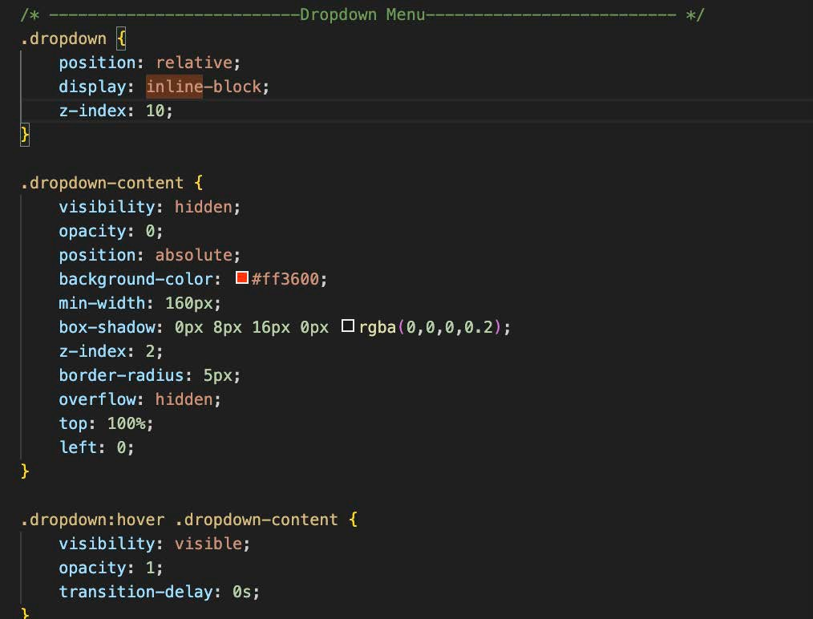
Tae jung - My Portfolio web
Static Website - Final Project
CSS Inline-Block Display
15 of 30: Showcase inline-block elements
Answer these questions:
What is an example of an element with inline-block display in your project?
Why does that element have inline-block display?

Slide 17
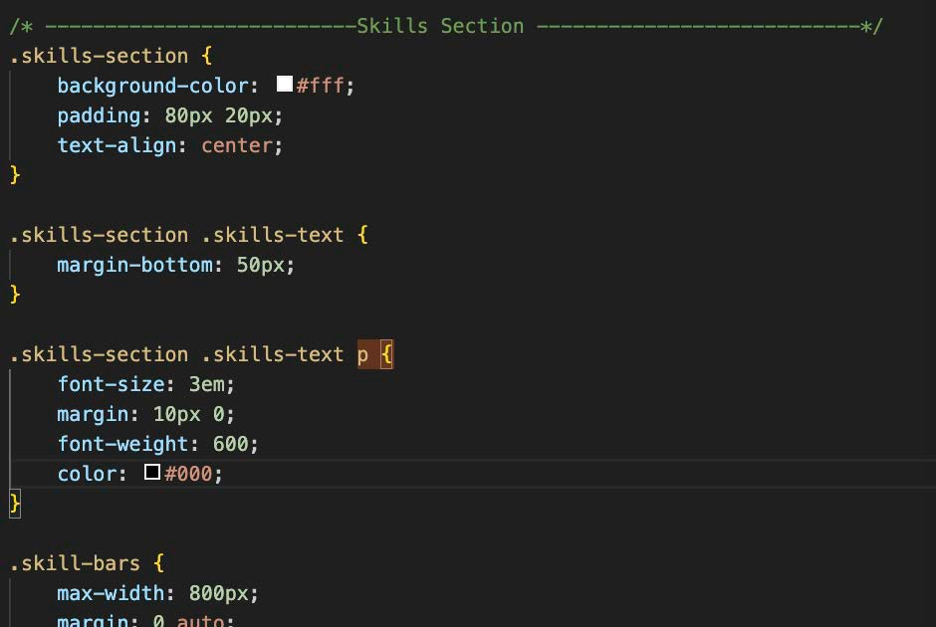
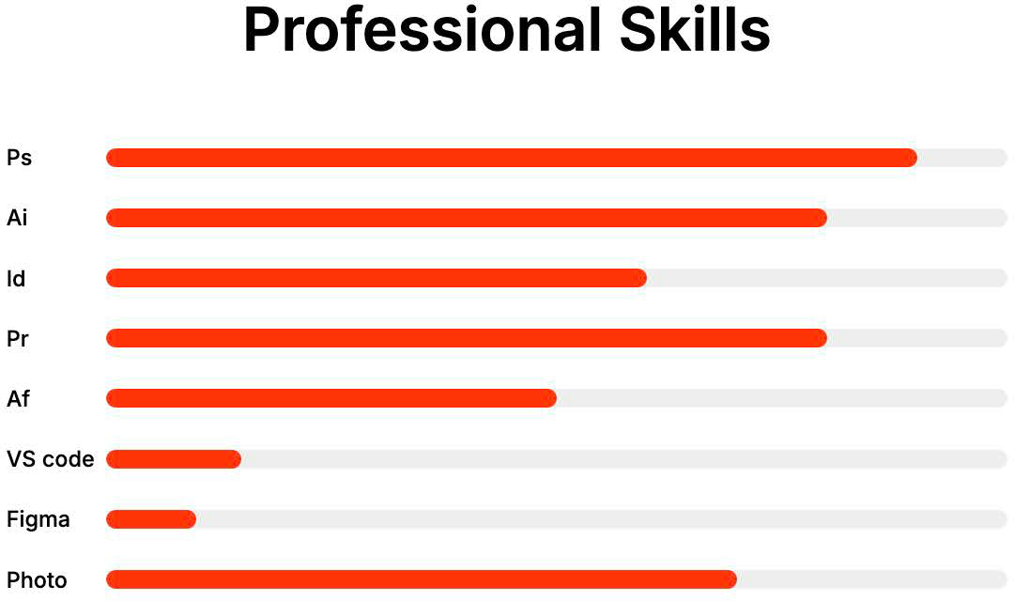
Tae jung - My Portfolio web
Static Website - Final Project
CSS Type Selector
16 of 30: Showcase CSS type selector
Answer these questions:
a) What is an example of a type selector in the CSS of your project?

Slide 18
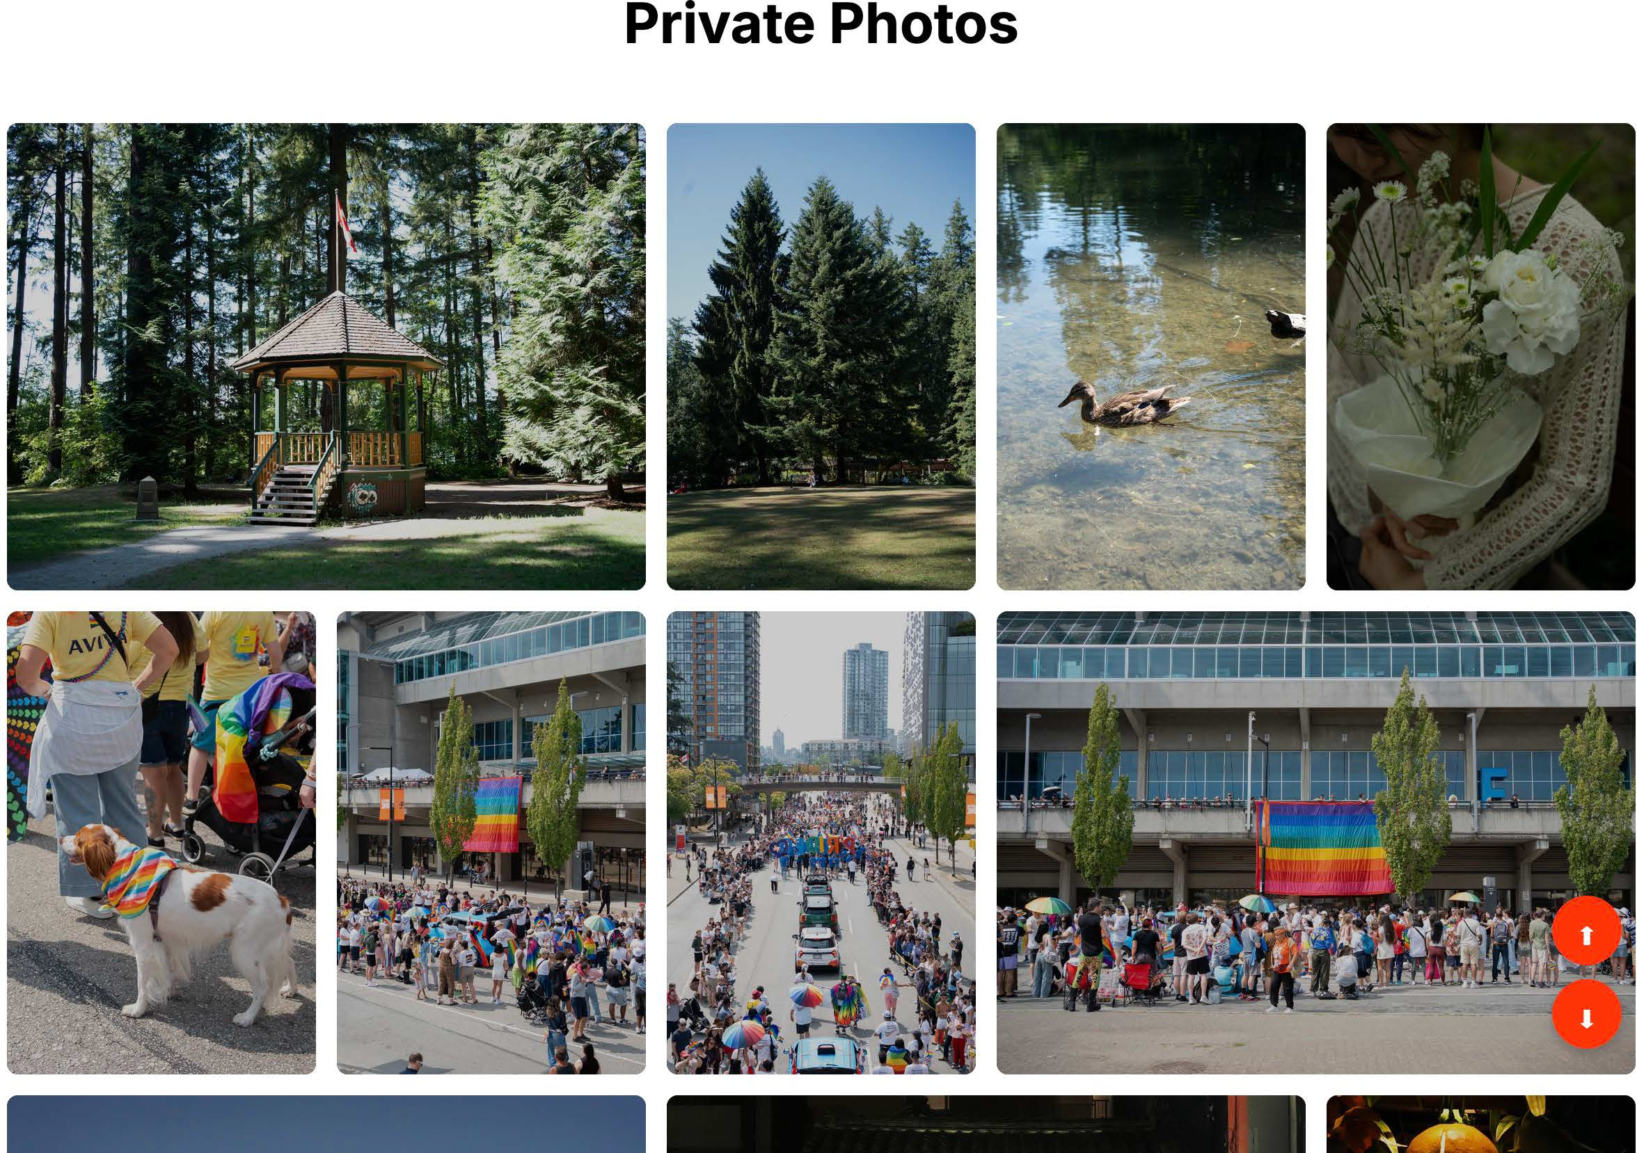
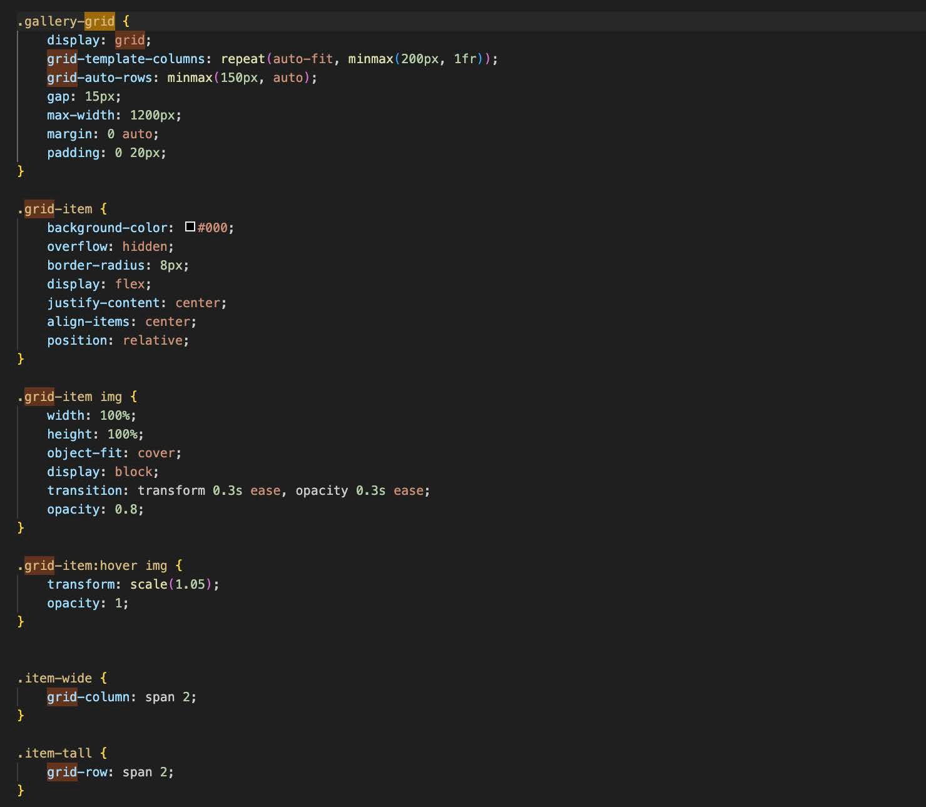
Tae jung - My Portfolio web
Static Website - Final Project
CSS Class Selector
17 of 30: Showcase CSS class selector
Answer these questions:
a) What is an example of a class selector in the CSS of your project?

Slide 19
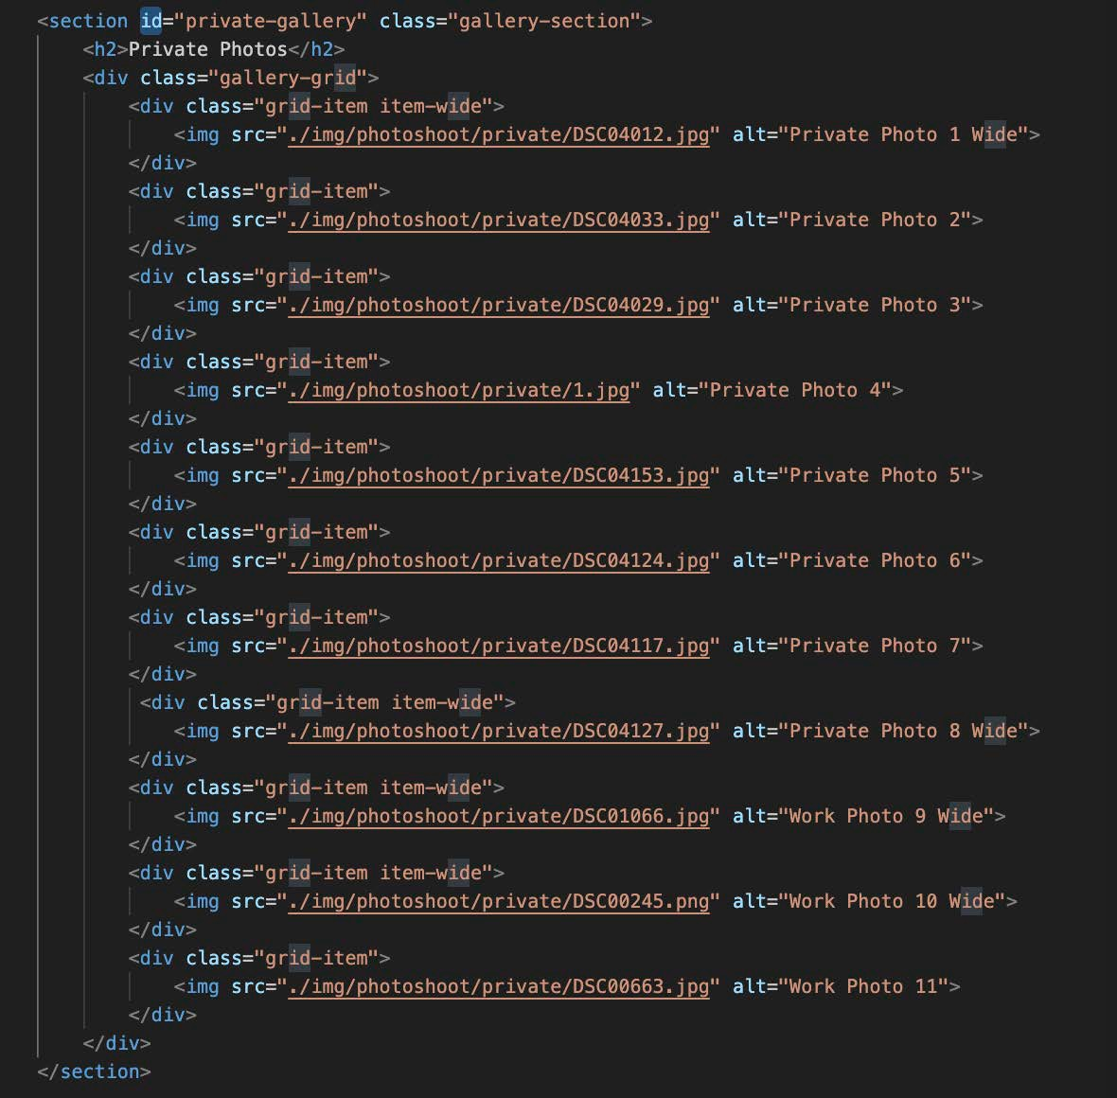
Tae jung - My Portfolio web
Static Website - Final Project
CSS Id Selector
18 of 30: Showcase CSS id selector
Answer these questions:
a) What is an example of an id selector in the CSS of your project?

Slide 20
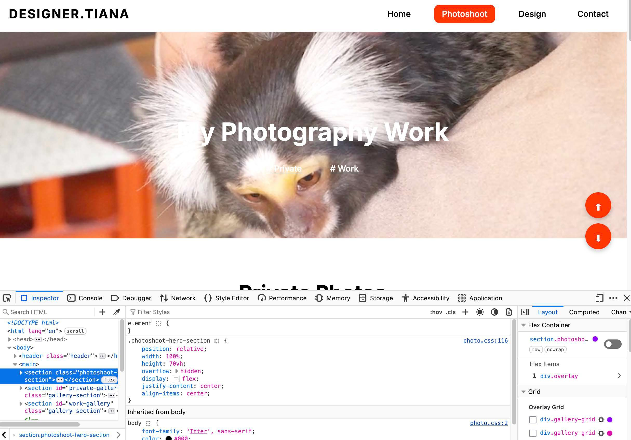
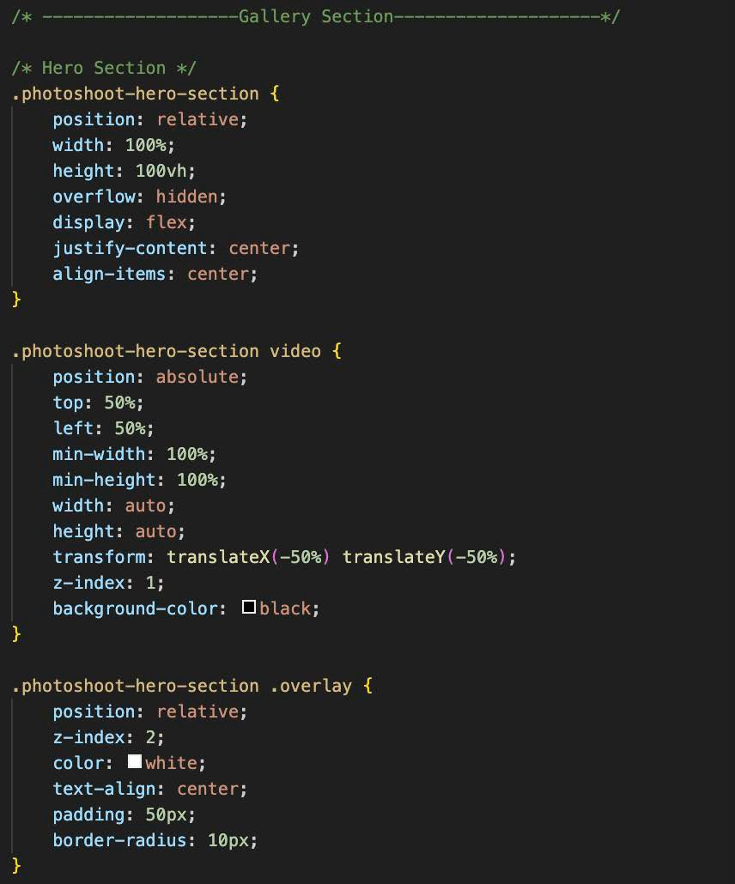
Static Website - Final Project
Tae jung - My Portfolio web
19 of 30: Showcase CSS Box Model
Answer these questions:
a) Can you showcase how you utilize the Box Model for styling elements?
CSS Box Model
Did you use the box-sizing property?
Does the element have margin?
Does the element have border?
Does the element have padding?
Does the element have width, height, or content?

Slide 21
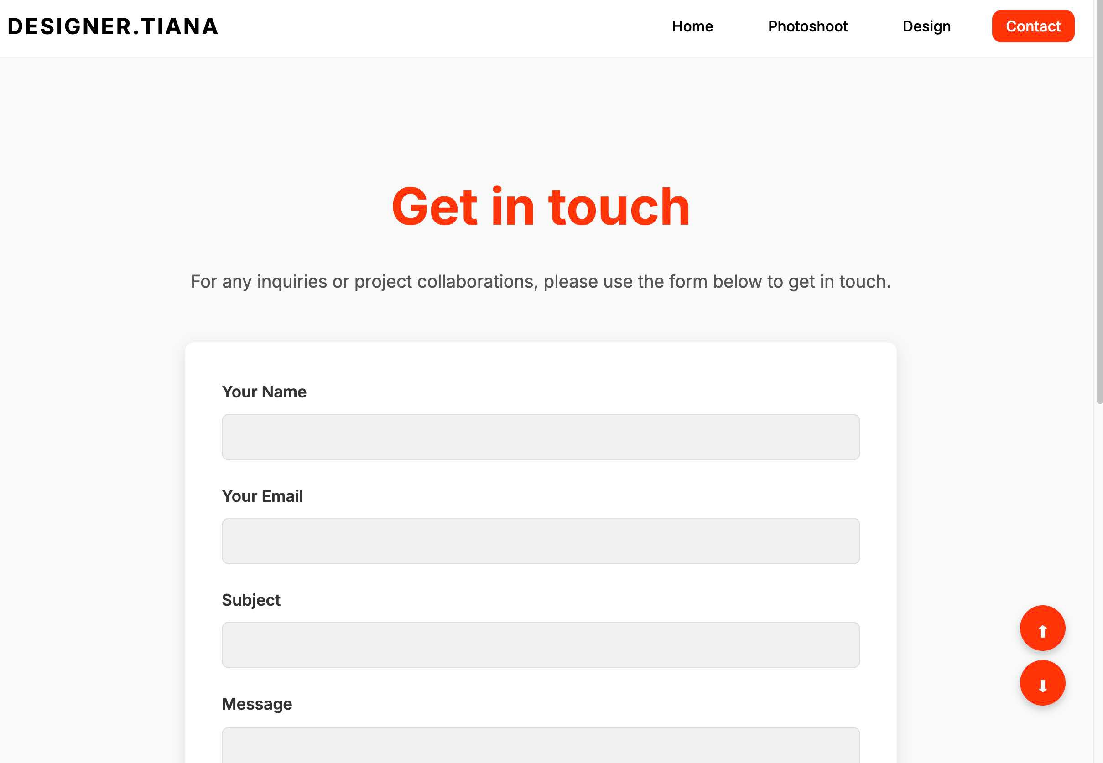
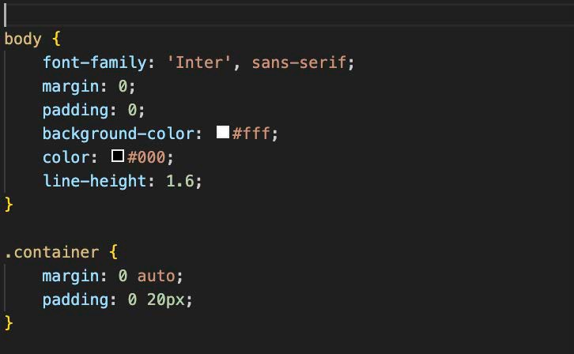
CSS Basic Properties
Static Website - Final Project
Tae jung - My Portfolio web
20 of 30: Showcase basic CSS properties
Answer these questions:
Did you use background properties?
Did you use color properties?
Did you use font and text properties?
Add a screenshot of the element
as it appears on the website in the browser,
and remove this frame and text.

Slide 22
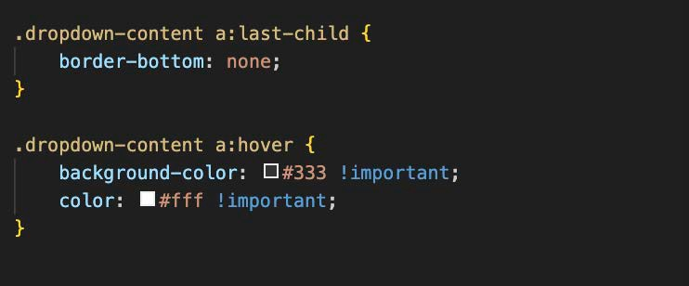
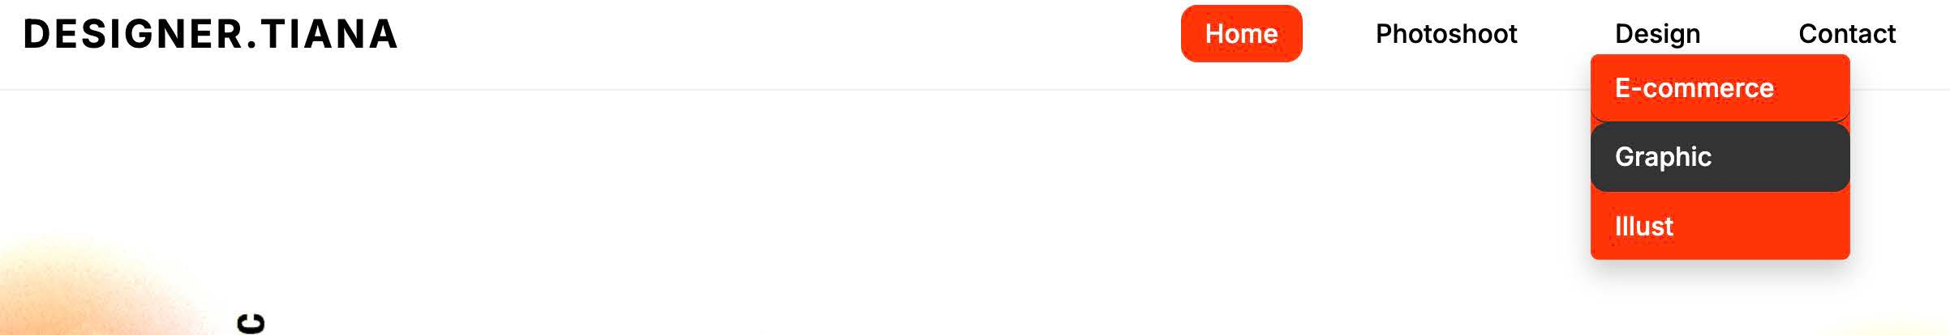
Tae jung - My Portfolio web
Static Website - Final Project
CSS Pseudo-classes & Link Styles
21 of 30: Showcase pseudo-classes with link styles
Answer these questions:
Did you use pseudo-classes in your project?
Showcase an example of :link
Showcase an example of :visited
Showcase an example of :hover
Showcase an example of :active or :focus
Did you follow the LVHA order for link styling?

Slide 23
CSS Float
Static Website - Final Project
Tae jung - My Portfolio web
22 of 30: Showcase Floated Element
Answer these questions:
Can you showcase an example of a Floated element?
Is it floated left or right? Why?
Add a screenshot of the floated element as it appears on the website in the browser,
and remove this frame and text.
Add a screenshot of the CSS, and remove this frame and text.

Slide 24
CSS Clear Property
Static Website - Final Project
Tae jung - My Portfolio web
23 of 30: Showcase Clear Property
Answer these questions:
Can you showcase an example of the clear property?
What elements are being cleared, and why?
Add a screenshot of the cleared elements as they appear on the website in the browser,
and remove this frame and text.
Add a screenshot of the CSS, and remove this frame and text.

Slide 25
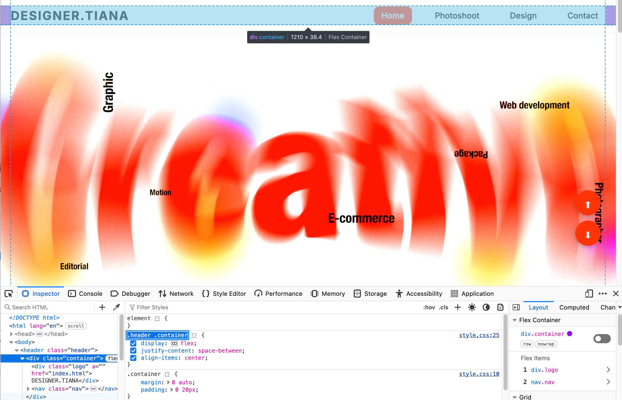
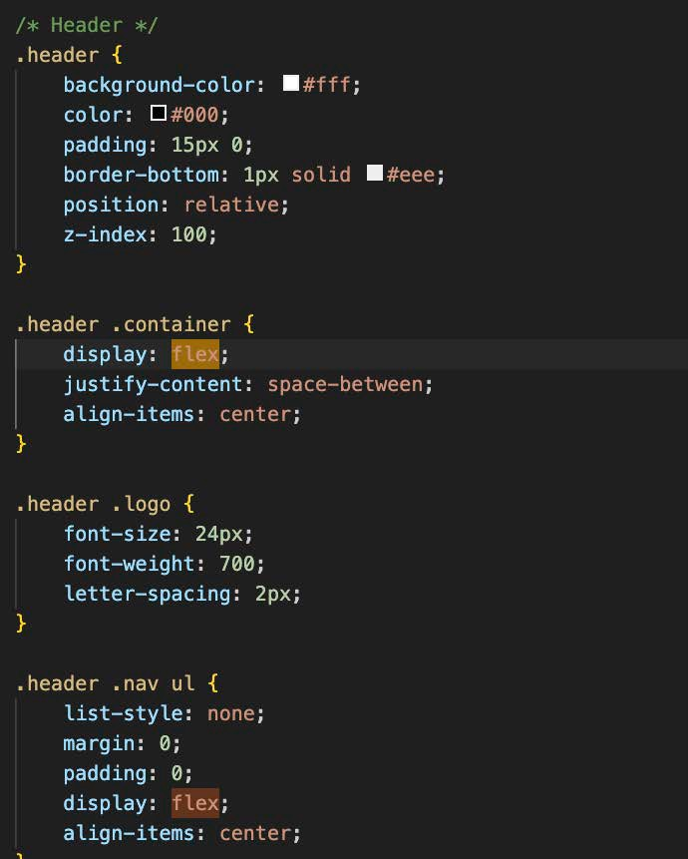
Tae jung - My Portfolio web
Static Website - Final Project
24 of 30: Showcase a Flexbox Container
CSS Flexbox Container
Answer these questions:
Can you showcase an example of an element with a display of Flex?
Did you use the justify-content property?
Did you use the align-items property?
Did you use the flex-wrap property?
Did you use the flex-direction property?
Did you use the gap property?
Did you use any other properties in the flex container? Which and why?

Slide 26
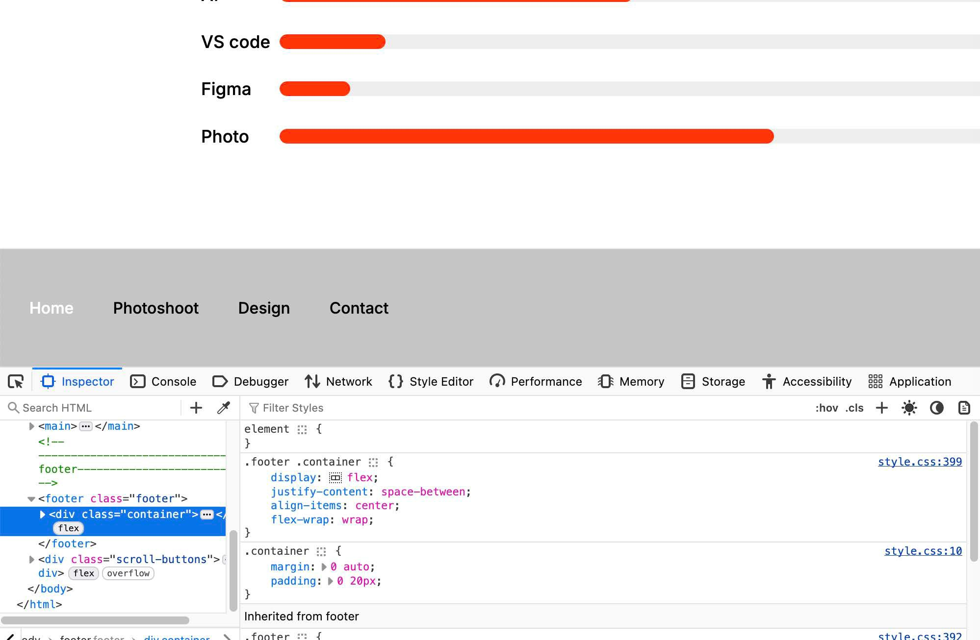
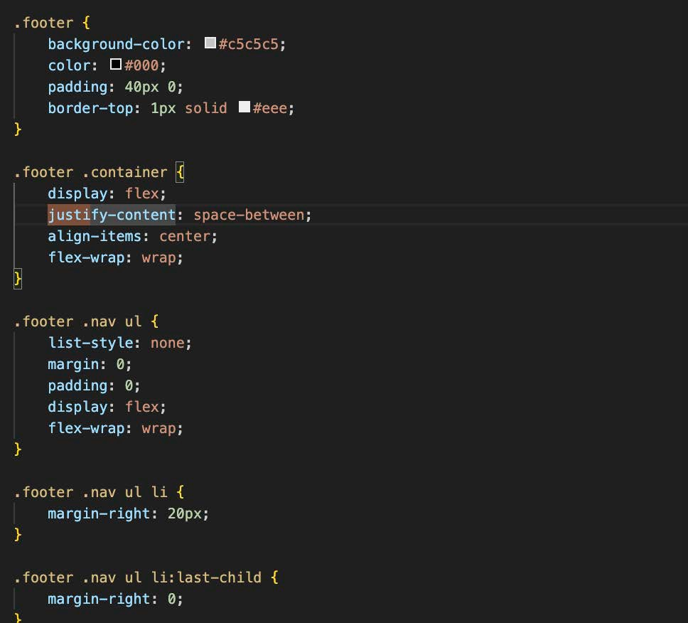
Tae jung - My Portfolio web
Static Website - Final Project
CSS Flexbox Items
25 of 30: Showcase Flexbox Items
Answer these questions:
Can you showcase an example of two or more elements that are contained in a flexbox?
Did you use the flex properties?
Did you use the align-self property?
Did you use the order property?

Slide 27
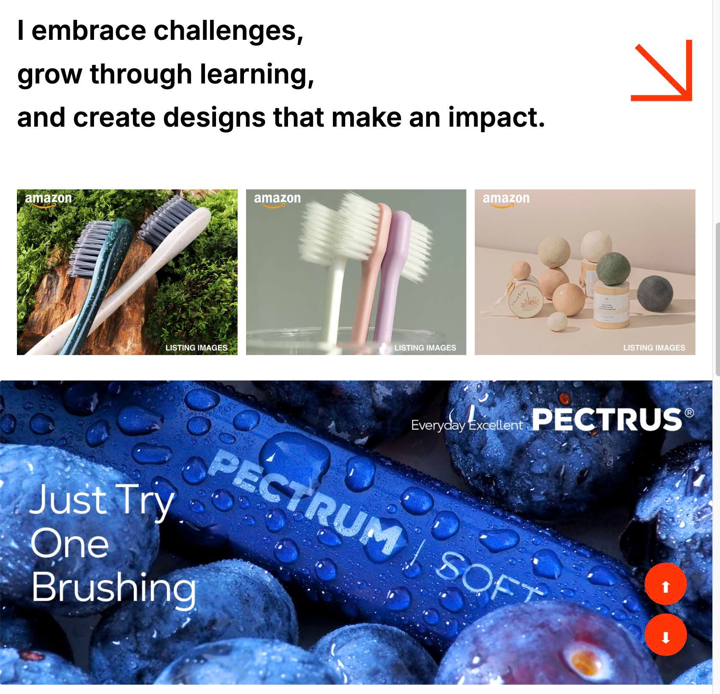
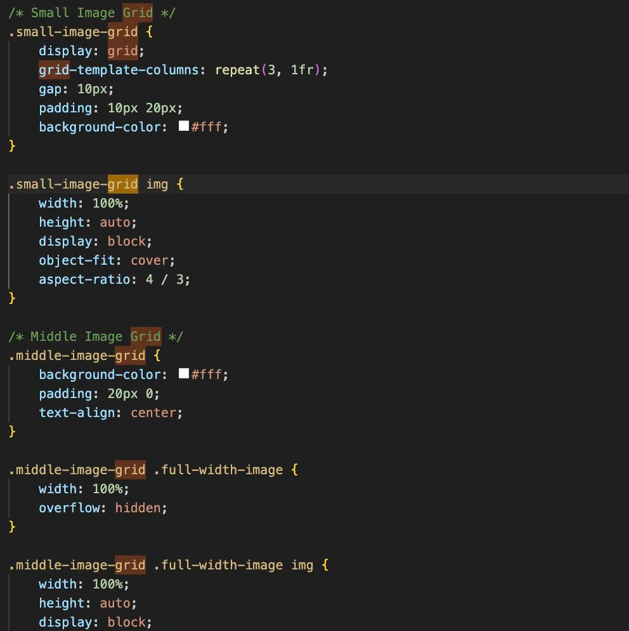
Tae jung - My Portfolio web
Static Website - Final Project
CSS Grid
26 of 30: Showcase CSS Grid
Answer these questions:
Can you showcase an example of an element with a display of grid?
Did you use grid-template-columns?
Did you use grid-template-rows?
Did you use grid areas? Named or unnamed?
Did you use gap property?
Did you use any other grid properties?

Slide 28
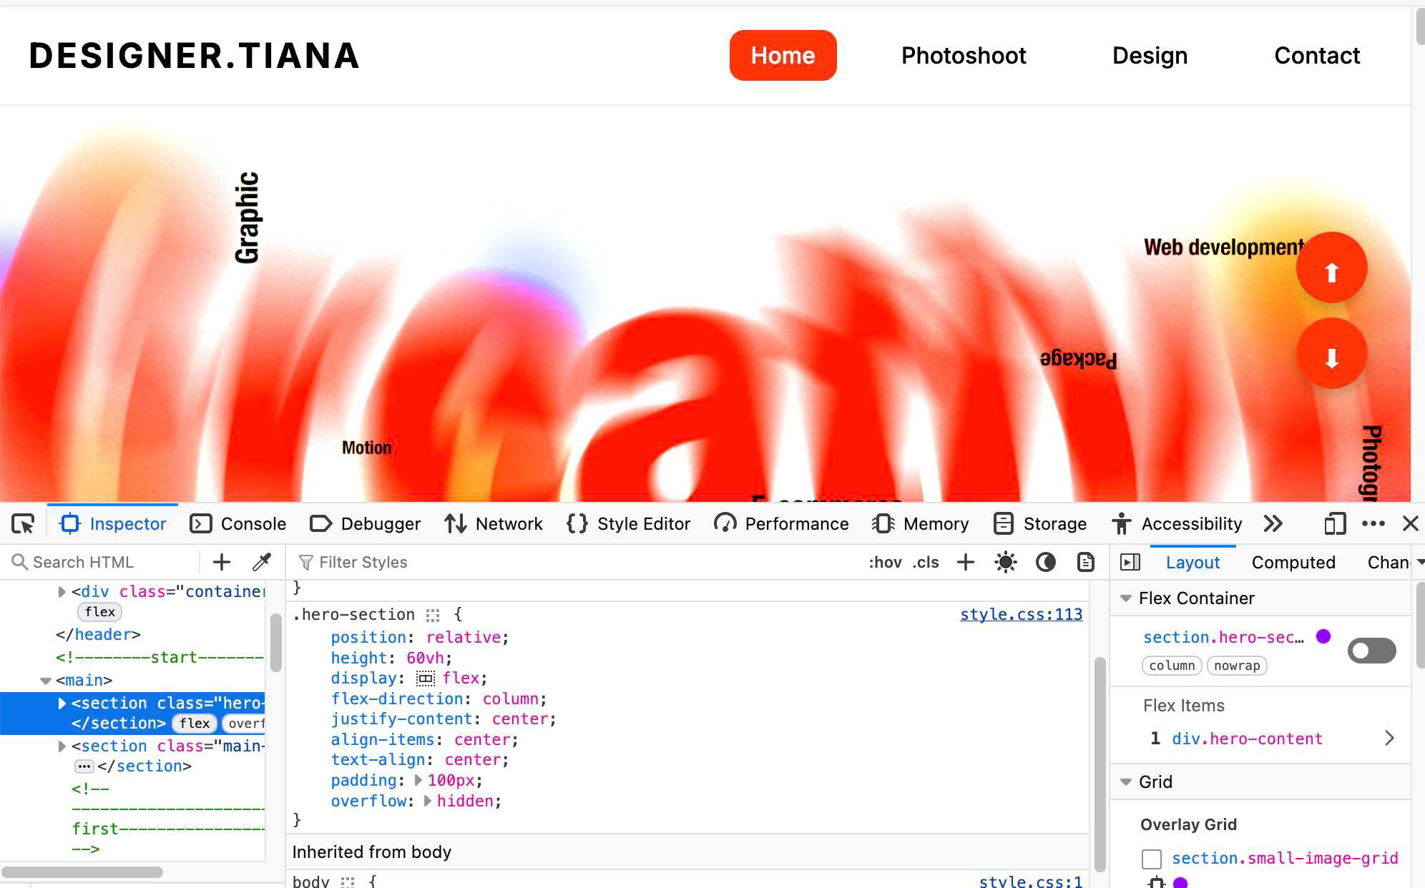
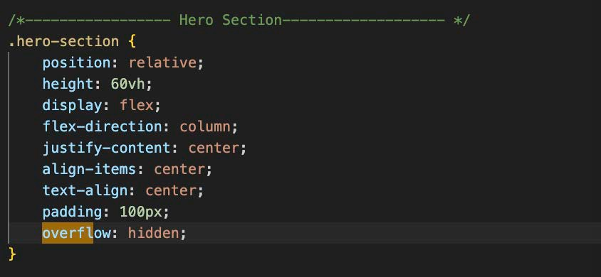
Tae jung - My Portfolio web
Static Website - Final Project
CSS Overflow Property
27 of 30: Showcase use of Overflow
Answer these questions:
a) Can you showcase an example of the overflow property?

Slide 29
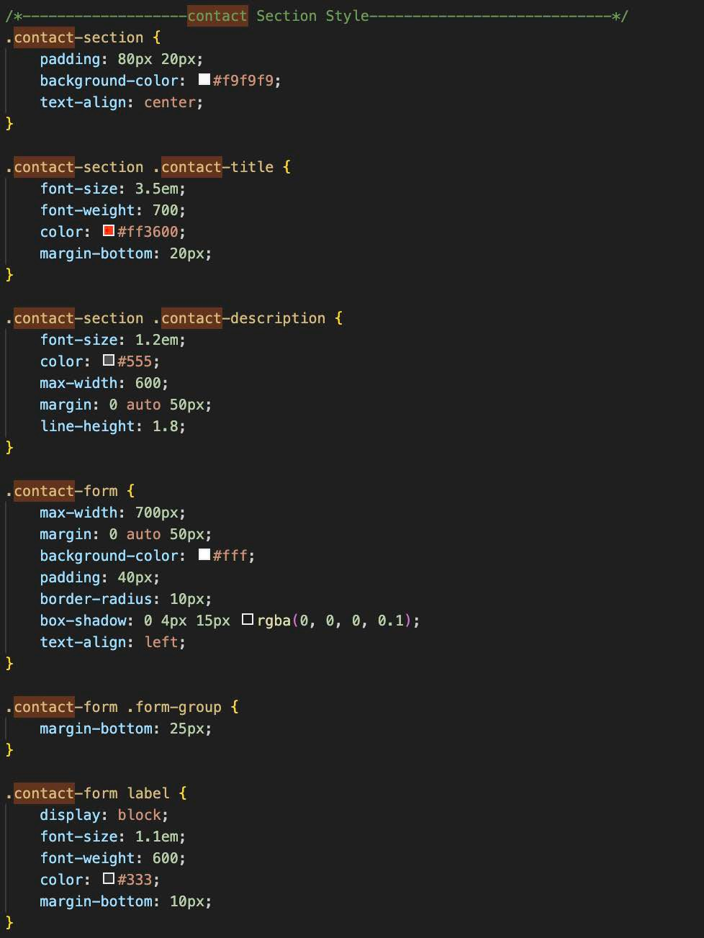
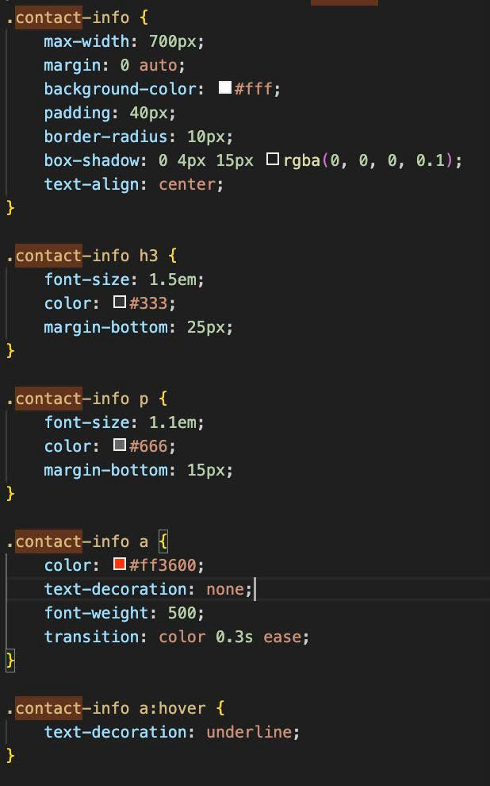
Tae jung - My Portfolio web
Static Website - Final Project
CSS Syntax & Formatting
28 of 30: Showcase CSS Syntax & Format
Answer these questions:
Does your CSS have proper indentation and white space usage?
Are your CSS declarations organized in a good order without specificity conflicts?

Slide 30
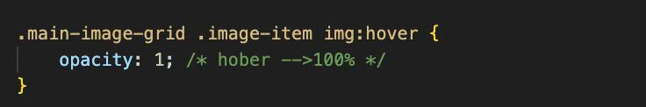
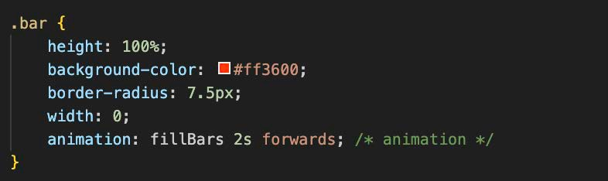
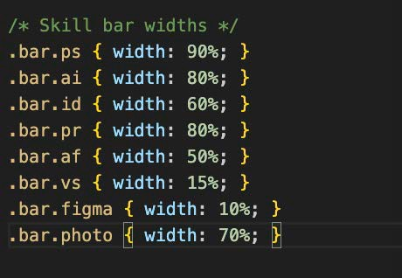
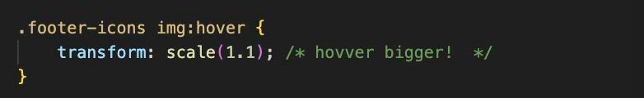
Tae jung - My Portfolio web
Static Website - Final Project
CSS Comments
29 of 30: Showcase CSS Comments
Answer these questions:
Did you use comment lines in your CSS?
Give some examples of where, how and why.

Slide 31
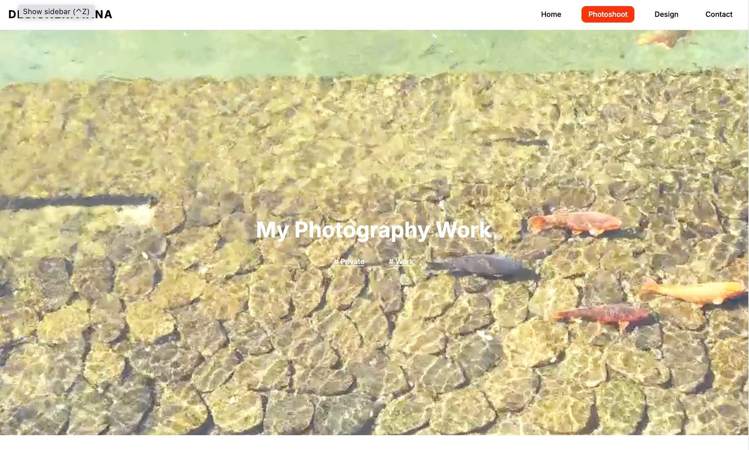
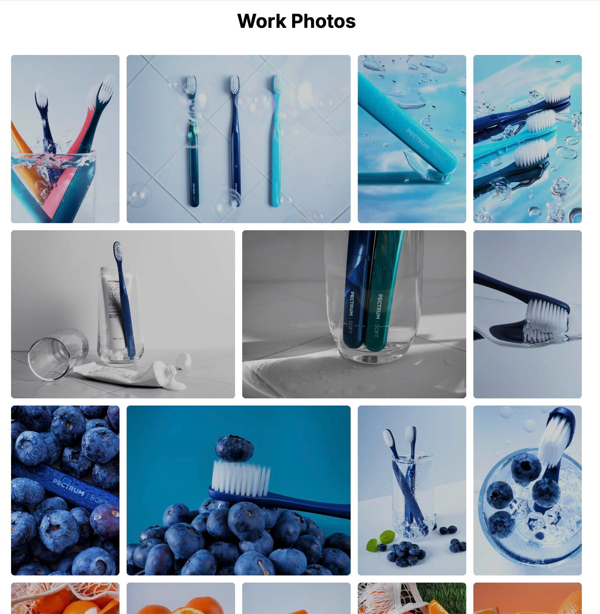

Tae jung - My Portfolio web
Static Website - Final Project
Biggest Challenge
30 of 30: Showcase your Biggest Challenge
Answer these questions:
What was your biggest challenge or struggle with the project so far?
If you overcame it, how did you do it?

